Slide 1
Polymorphism
Said Nabi

Slide 2
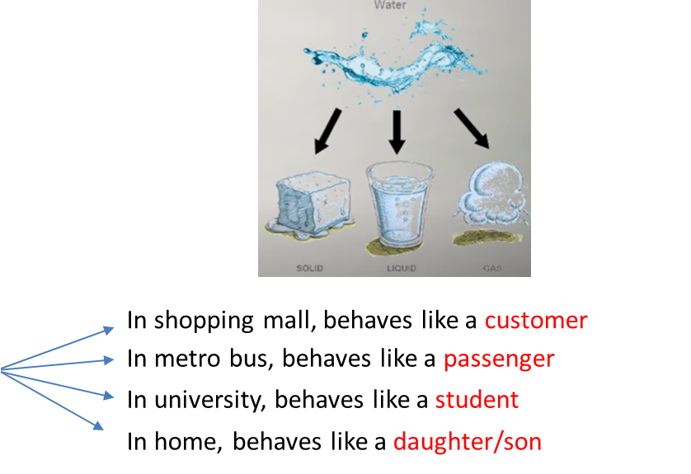
Polymorphism
Combination of two Greek words
    Poly (many) morphism (form)
Water -> Solid, Liquid, Gas
For example, A Person
Same person have different behavior in different situations. This is called Polymorphism.

Slide 3
Understanding With an Example
Suppose you are building a simple graphics editor.
You have different types of shapes:
  Circle
  Triangle
  Rectangle
Each shape can be drawn, but each in its own way.

Slide 4
Understanding With an Example
class Shape {
public:
void draw() {
cout << "Drawing Shape" << endl;
}
};
class Triangle : public Shape {
public:
void draw() {
cout << "Drawing Triangle" << endl;
}
};
class Circle : public Shape {
public:
void draw() {
cout << "Drawing Circle" << endl;
}
};
int main(){
Triangle t;
Circle c;
t.draw();
c.draw();
}

Slide 5
Understanding With an Example
Problems with this approach?
Tight coupling to specific types
  You must know at compile-time whether it’s a Triangle or Circle.
Manual Management of Every Type
  If later you add Rectangle, Polygon, Ellipse, etc.,
  You need to create a new variable for each type.
Not Extendable
  You cannot store all different shapes together in a single collection like an array or vector of Shape.
Violates "Open for Extension" Principle
  Adding a new shape forces you to modify the existing code (not good design).

Slide 6
Understanding With an Example
Why Can’t we Just Treat All Shapes as Shape?
A Circle is a Shape.
A Triangle is a Shape.
A Rectangle is a Shape.
This is the is-a relationship created by inheritance!

Slide 7
Understanding With an Example
How about storing different Shapes as Shape type?
Shape s1 = Triangle();
Shape s2 = Circle();
s1.draw();
s2.draw();
Now we can create an array or list of type Shape that can hold objects of all types of shapes, great!

Slide 8
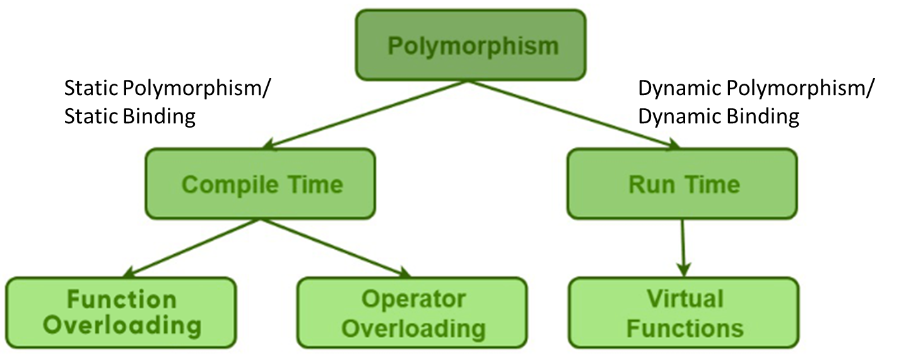
Polymorphism

Slide 9
Binding Process
Binding is the process to associate variable/ function names with memory addresses
Binding is done for each variable and functions.
For functions, it means that matching the call with the right function definition by the compiler.

Slide 10
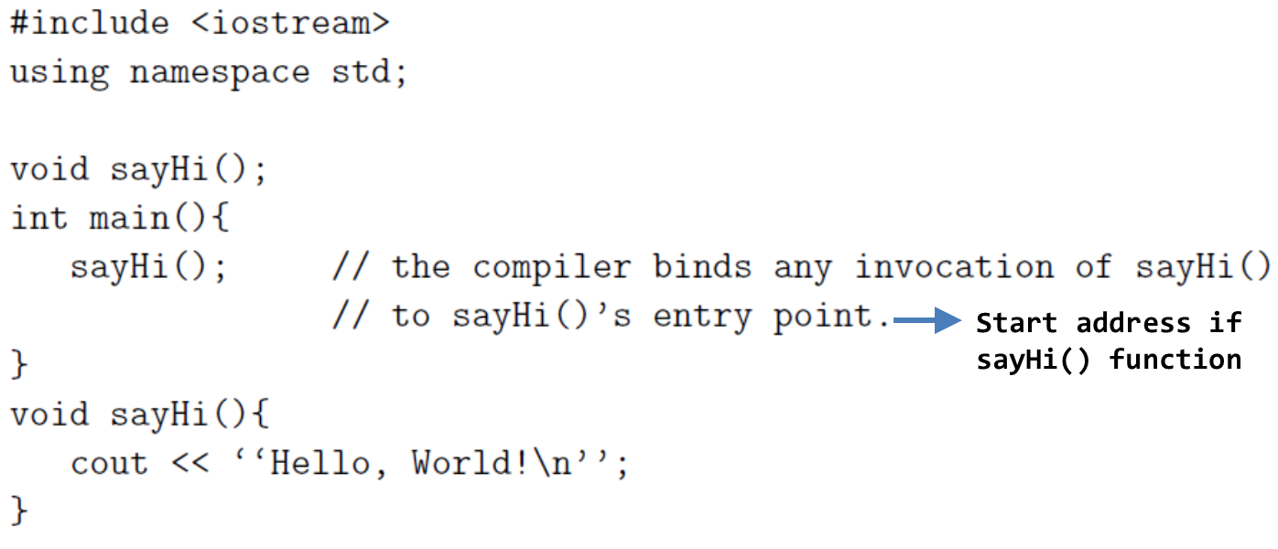
Compile-time Binding (Static Binding)
Compile-time binding is to associate a function's name with the entry point (start memory address) of the function at compile time (also called early binding)

Slide 11
Run-time Binding (Dynamic Binding)
Run-time binding is to associate a function's name with the entry point (start memory address) of the function at run time (also called late binding)
C++ provides both compile-time and run-time bindings:
  Non-Virtual functions (you have implemented so far) are binded at compile time
  Virtual functions (in C++) are binded at run-time.
Why virtual functions are used?
  To implement Polymorphism

Slide 12
Static Polymorphism
//Function Overloading
class SomeClass
{
public:
// function with 1 int parameter
void func(int x)
{
cout << "value of x is " << x << endl;
}
// function with same name but 1 double parameter
void func(double x)
{
cout << "value of x is " << x << endl;
}
// function with same name and 2 int parameters
void func(int x, int y)
{
cout << "value of x and y is " << x << ", " << y << endl;
}
};
int main() {
SomeClass obj1;
// The first 'func' is called
obj1.func(7);
// The second 'func' is called
obj1.func(9.132);
// The third 'func' is called
obj1.func(85,64);
return 0;
}

Slide 13
Dynamic Polymorphism
There is an inheritance hierarchy
There is a pointer/reference of base class type that can point/refer to derived class objects

Slide 14
Pointers to Derived Classes
C++ allows base class pointers or references to point/refer to both base class objects and also all derived class objects.
Let’s assume:
  class Base { … };
  class Derived : public Base { … };
Then, we can write:
  Base *p1;
  Derived d_obj; p1 = &d_obj;
  Base *p2 = new Derived;

Slide 15
Pointers to Derived Classes (contd.)
While it is allowed for a base class pointer to point to a derived object, the reverse is not true.
  base b1;
  derived *pd = &b1; // compiler error

Slide 16
Pointers to Derived Classes (contd.)
Access to members of a class object is determined by the type of
  An object name (i.e., variable, etc.)
  A reference to an object
  A pointer to an object

Slide 17
Pointers to Derived Classes (contd.)
Using a base class pointer (pointing to a derived class object) can access only those members of the derived object that were inherited from the base.
This is because the base pointer has knowledge only of the base class.
It knows nothing about the members added by the derived class.

Slide 18
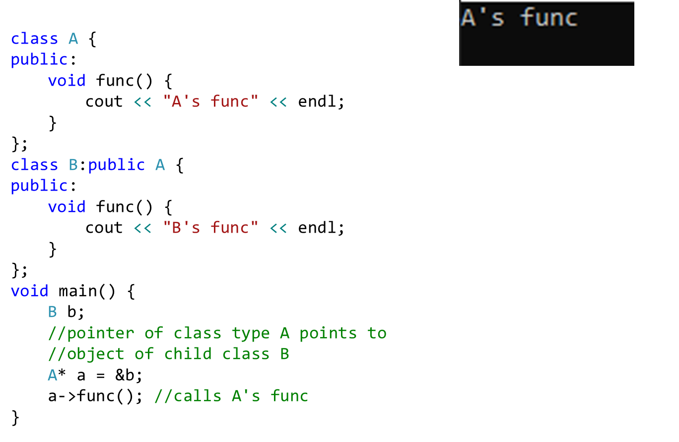
Pointer of Base Class

Slide 19
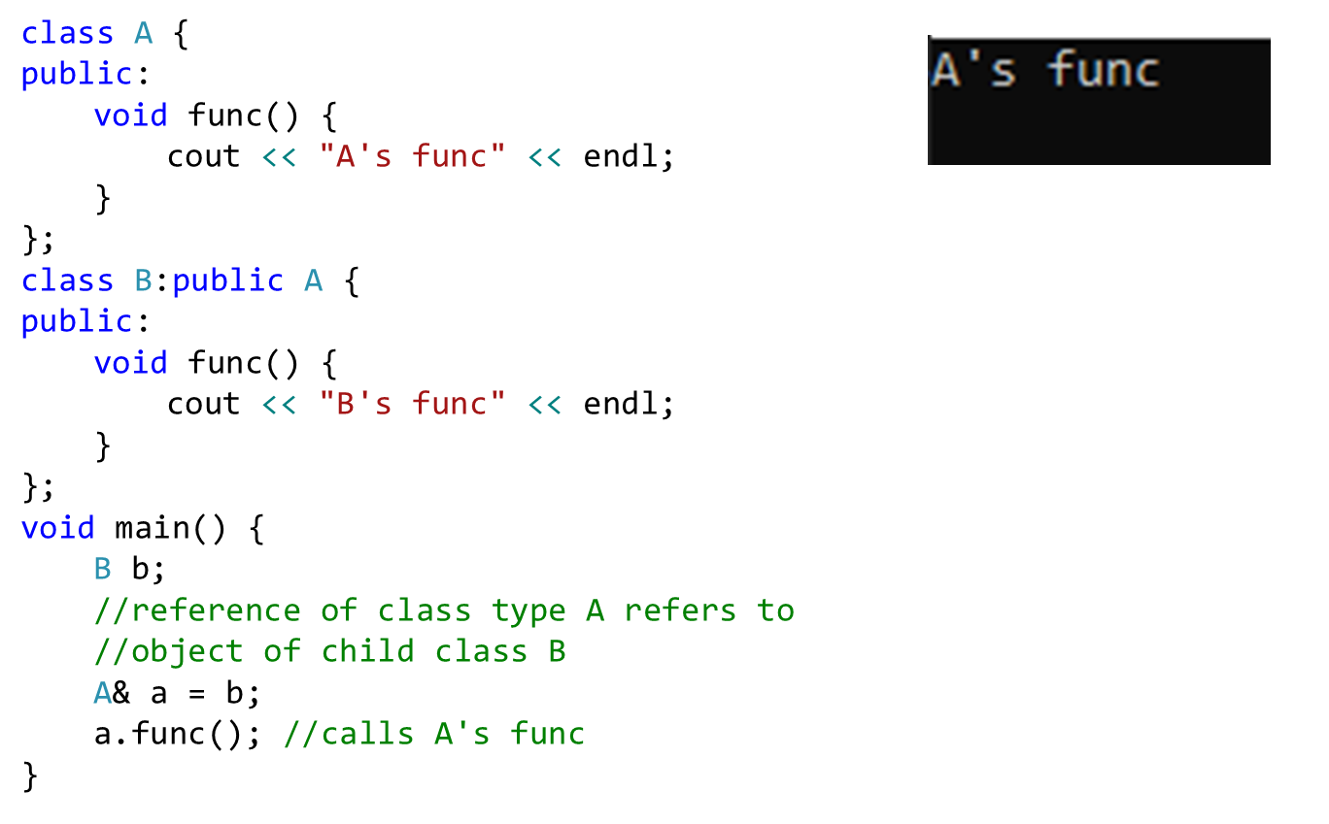
Reference of Base Class

Slide 20
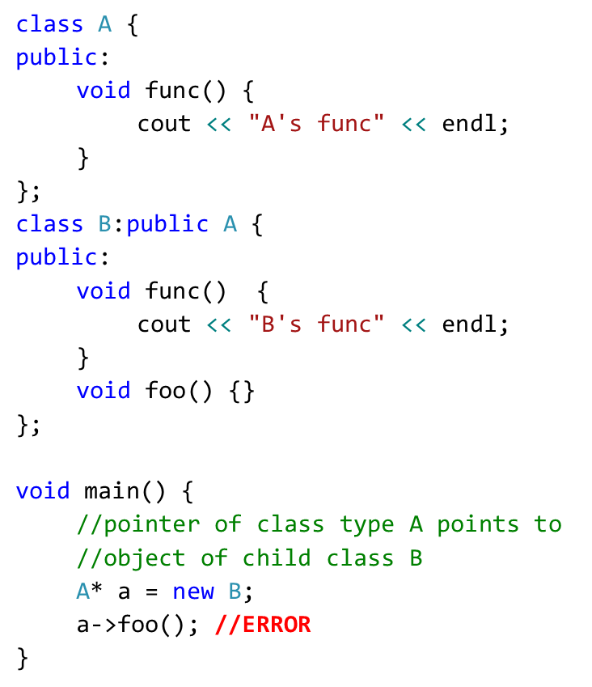
Pointer of Base Class
Parent class pointer/reference has NO KNOWLEDGE of child class functions

Slide 21
Summary – Based and Derived Class Pointers
Base-class pointer pointing to base-class object
  Straightforward
Derived-class pointer pointing to derived-class object
  Straightforward
Base-class pointer pointing to derived-class object
  Safe
  Can access non-virtual methods of only base-class
  Can access virtual methods of derived class
Derived-class pointer pointing to base-class object
  Compilation error

Slide 22
Dynamic Polymorphism
There is an inheritance hierarchy
There is a pointer/reference of base class type that can point/refer to derived class objects
There is a pointer of base class type that is used to invoke virtual functions of derived class.
The first class that defines a virtual function is the base class of the hierarchy that uses dynamic binding for that function name and signature.
Each of the derived classes in the hierarchy must have a virtual function with same name and signature. Not an error but needed for dynamic binding

Slide 23
Virtual Functions
Virtual functions ensure that the correct function is called for an object, regardless of the type of reference (or pointer) used for function call
They are mainly used to achieve Runtime polymorphism
Functions are declared with a virtual keyword in base class
The resolving of function call is done at runtime

Slide 24
Virtual Functions
The virtual-ness of an operation is always inherited
If a function is virtual in the base class, it must be virtual in the derived class
Even if the keyword “virtual” not specified (But always use the keyword in children classes for clarity.)
  If no overridden function is provided, the virtual function of base class is used

Slide 25
Virtual function
Declaring a function virtual will ensure late-binding
To declare a function virtual, we use the Keyword virtual:
class Shape
{
public:
virtual void sayHi ()
{
cout <<“Just hi! \n”;
}
};

Slide 26
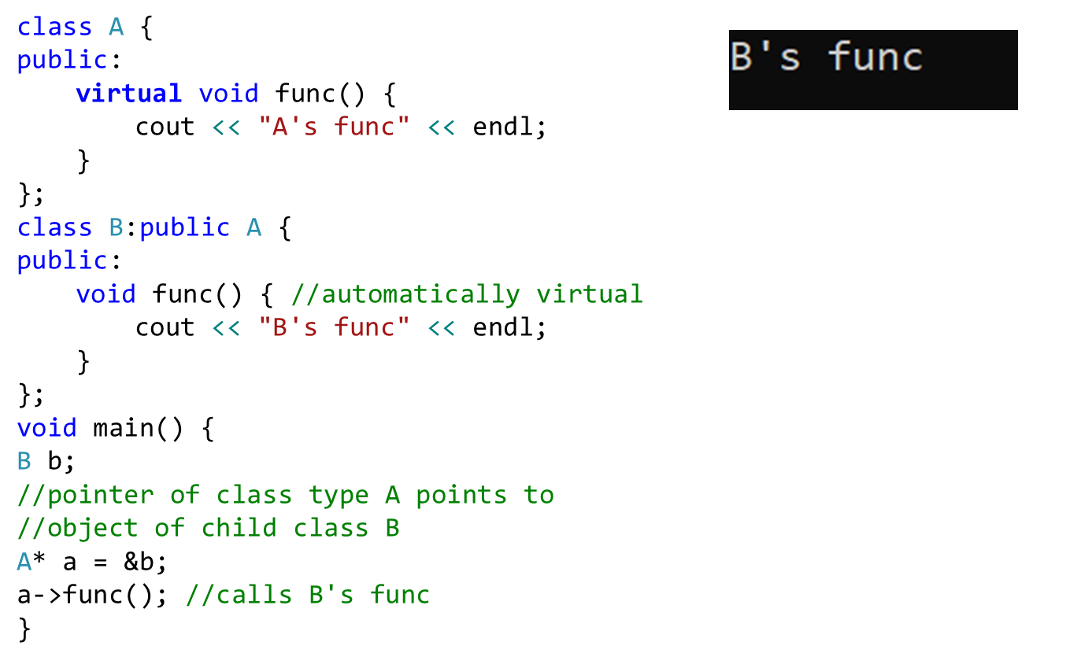
Virtual function

Slide 27
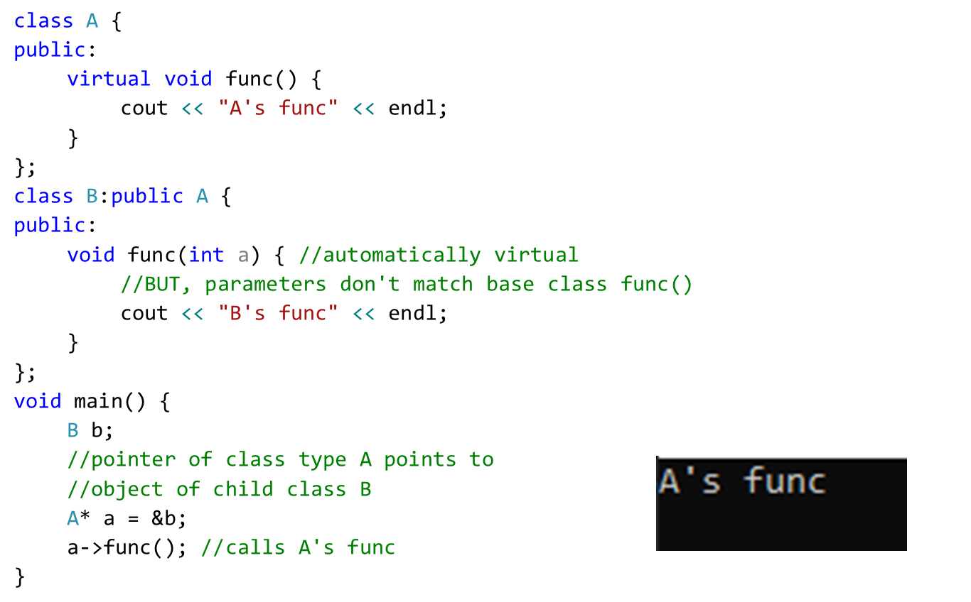
Virtual function
Overridden function parameters in derived class must be same as base class, otherwise base class func will be called

Slide 28
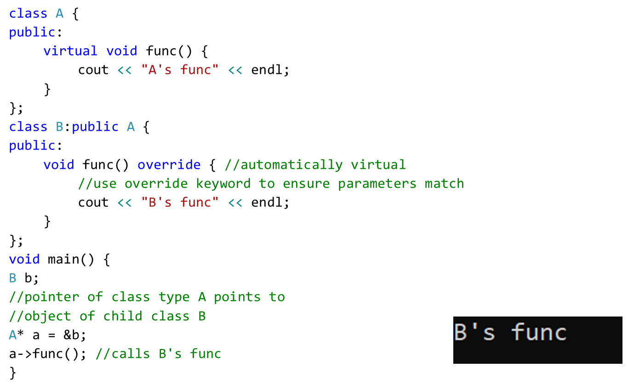
Virtual function
Override keyword

Slide 29
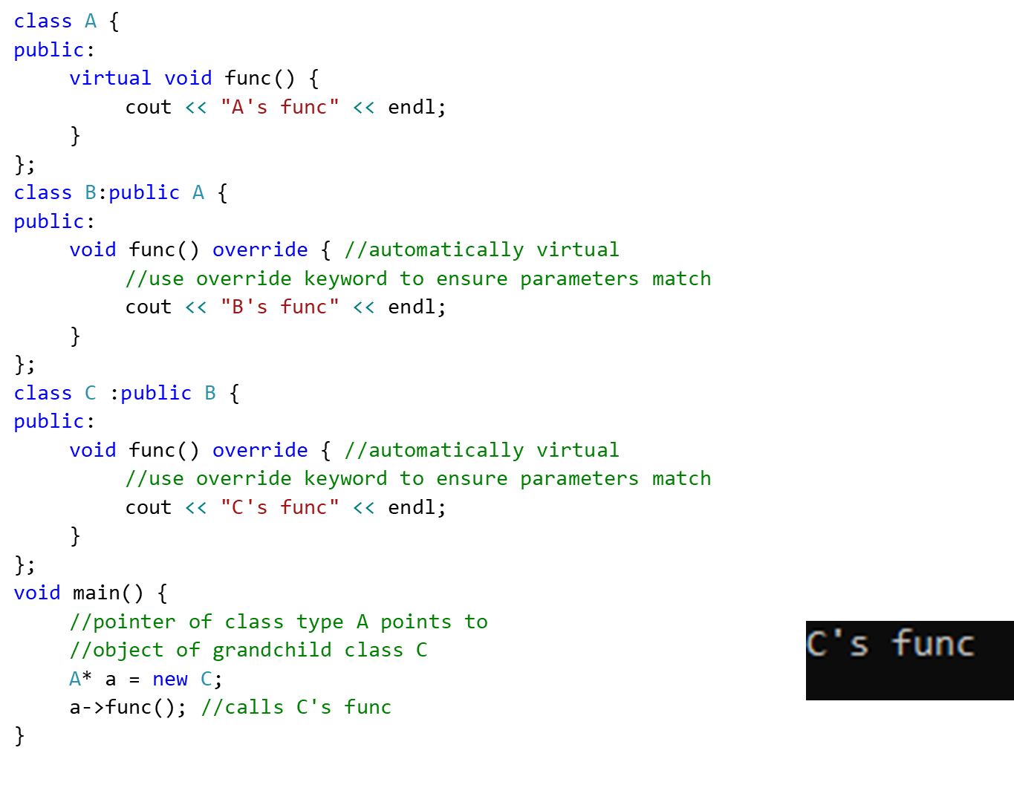
Virtual function with Multilevel Inheritance

Slide 30
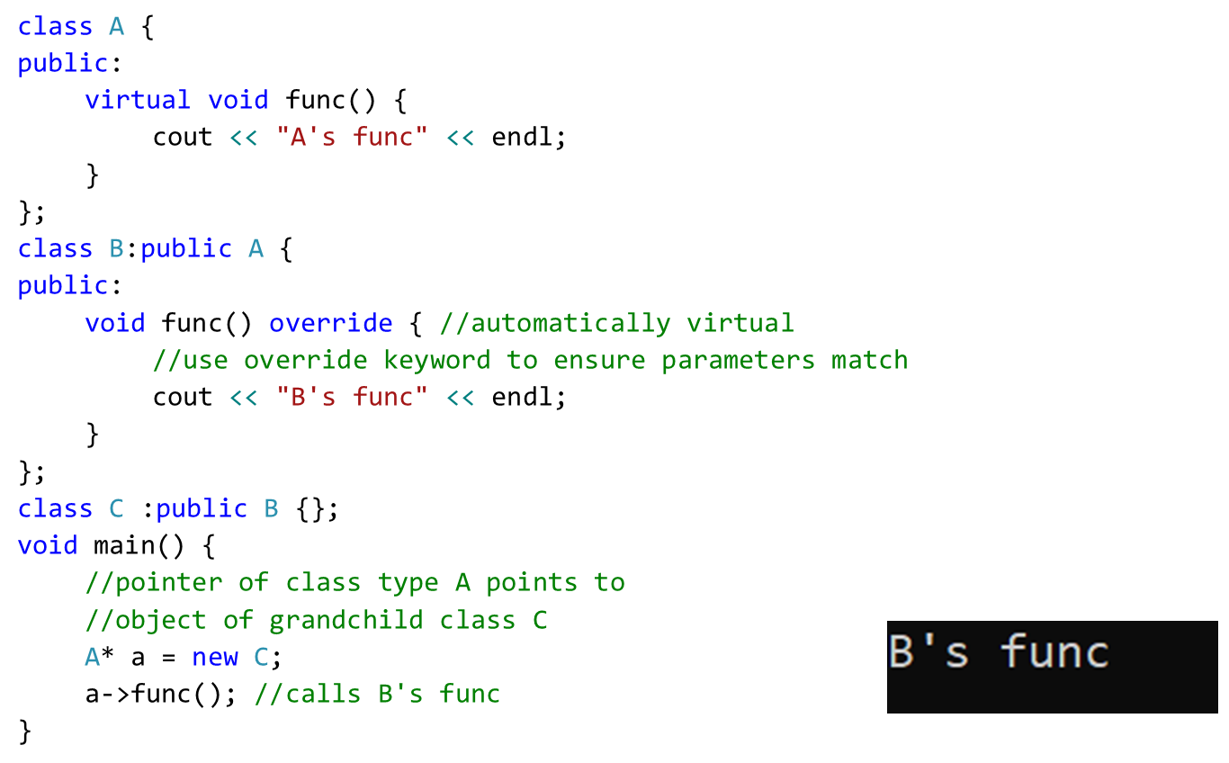
Virtual function with Multilevel Inheritance
Class C does not override func(), if parent of class C has func(), that one is executed

Slide 31
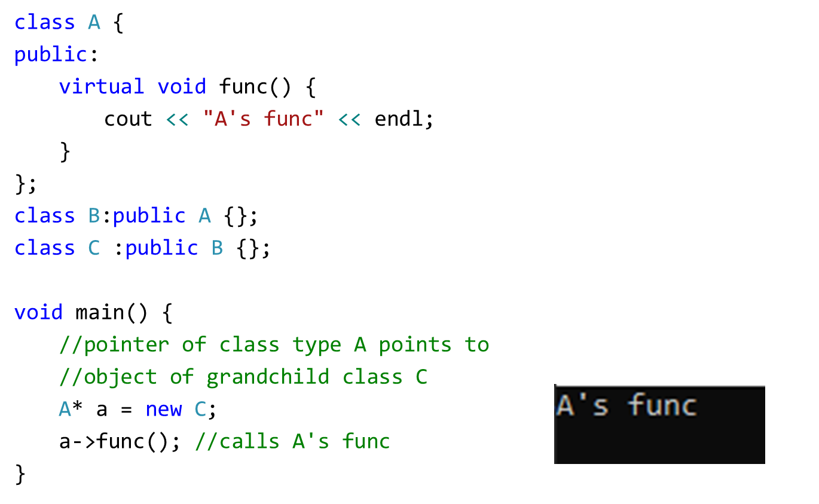
Virtual function with Multilevel Inheritance
Class C does not override func(), class B also does not override func(),
A’s func is executed

Slide 32
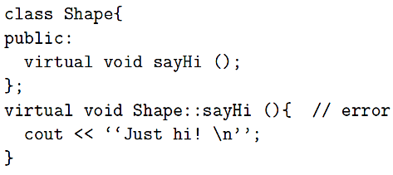
Virtual Functions
If the member function definition is out-of-line, the keyword virtual must not be specified again.
Virtual functions can not be stand-alone or static functions
A destructor can be virtual but a constructor cannot

Slide 33
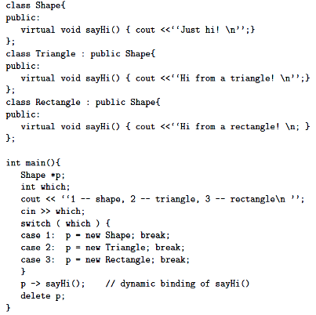
Virtual Functions based Shapes

Slide 34
Virtual Functions
How to declare a member function virtual:
class Animal{
public:
virtual void id(){cout << "animal";}
};
class Cat : public Animal{
public:
virtual void id(){cout << "cat";}
};
class Dog : public Animal{
public:
virtual void id(){cout << "dog";}
};

Slide 35
Virtual Functions
If the member functions id( ) are declared virtual, then the code:
Animal *pA[] = {new Animal, new Dog, new Cat};
for(int i=0; i<3; i++)
pA[i]->id();
will print animal, dog, cat

Slide 36
With Multiple Inheritance
class A {
public:
void print() { //not virtual
cout << "Print class A" << endl;
}
~A() {
cout << "A's destructor" << endl;
}
};
class B {
public:
virtual void print() {
cout << "Print class B" << endl;
}
~B() {
cout << "B's destructor" << endl;
}
};
class C :public B,public A {
public:
void print() {
cout << "Print class C" << endl;
}
~C() {
cout << "C's destructor" << endl;
}
};
int main() {
B *b=new C;
A* a=new C;
b->print();
a->print();
return 0;
}
Output:
Print class C
Print class A

Slide 37
Benefits of Polymorphism
Better Design!
Flexibility
You can always change the subclass object assigned to the superclass reference variable, without breaking other code
The modification will only affect the new object, not those using it
Need to Write Less code
Reference variable of superclass type can be assigned object of any subclass
Easy to Extend
Write code that doesn’t have to change when you introduce new subclass types into the program.
Object Oriented Programming-Spring 23

Slide 38
Pointers to Derived Classes
We can create an array of base class pointers, and these pointers can hold objects of different derived classes
Shape *p[4];
p[0] = new Triangle (3, 4, 5, 19 );
p[1] = new Circle (3, 4, 5 );
p[2] = new Rectangle ( 3, 4, 10 , 20 );
p[3] = new Cylinder ( 3, 4, 5, 10 );
for ( int loop = 0; loop < 4; loop ++ )
{ p[loop]->draw ();
cout << “The area is “ << p[loop]->GetArea ( );
}

Slide 39
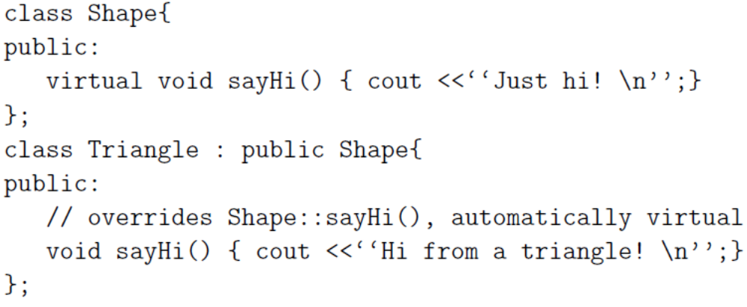
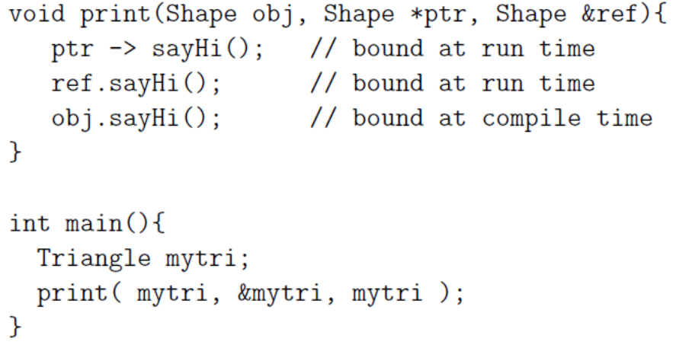
Dynamic Polymorphism Example (using Base Class’s Pointers and References)

Slide 40
Virtual Destructors
Constructors cannot be virtual, but destructors can be virtual when a constructor of a class is executed there is no virtual table in the memory, means no virtual pointer defined yet.
Ensures the derived class destructor is called when a base class pointer is used, while deleting a dynamically created derived class object.
  virtual ~Shape(){….}
  Reason: to invoke the correct destructor, no matter how object is accessed

Slide 41
Virtual Destructors (contd.)
Using non-virtual destructor
class base {
public:
~base() {
cout << “destructing base\n”;
}
};
class derived : public base {
public:
~derived() {
cout << “destructing derived\n”;
}
};
int main()
{
base *p = new derived;
delete p;
return 0;
}
Output:
  destructing base

Slide 42
Virtual Destructors (contd.)
Using virtual destructor
class base {
public:
virtual ~base() {
cout << “destructing base\n”;
}
};
class derived : public base {
public:
~derived() {
cout << “destructing derived\n”;
}
};
int main()
{
base *p = new derived;
delete p;
return 0;
}
Output:
  destructing derived
  destructing base

Slide 43
